Slide 1

ICTU — INSTITUTE OF COMPUTING TECHNOLOGY
BORDERWATCH
High-Availability GPS Goods-in-Transit Surveillance System
Spring Boot 3.3 / Java 21 + React 18 / TypeScript + CEMAC Customs Corridors
SEN3244 — Software Architecture
Group 7 — Bachelor of Software Engineering, Year 3
Academic Year 2025 – 2026
Nguend Arthur Johann (ICTU20223180) + Tambi Emmanuel Tambi (ICTU20233726)

Slide 2
PRESENTATION OVERVIEW
01
02
Introduction
Literature Review
System overview, problem statement, and project objectives for the BorderWatch surveillance platform.
Development methodologies and architectural foundations including Scrum, Hexagonal Architecture, and microservices.
03
04
Methodology & Materials
Results & Discussion
System design, Hexagonal Architecture, authentication, RBAC, test strategy, and technology stack.
Performance benchmarks exceeding all targets, CI/CD pipeline, monitoring, and Kubernetes deployment.
05 — Recommendations & Conclusion

Slide 3

01
INTRODUCTION
Problem statement, system overview, and project objectives for the BorderWatch surveillance platform.

Slide 4
INTRODUCTION
LITERATURE REVIEW
METHODOLOGY
RESULTS
CONCLUSION
System Overview & Problem Statement
BorderWatch is a real-time distributed GPS surveillance system for monitoring goods-in-transit across CEMAC customs corridors.
It processes 10,000+ GPS pings/second from truck-mounted beacons, applies the Haversine algorithm for geofencing, and records violations with SHA-256 blockchain audit trails.
Coverage: Douala–N'Djamena (2,500 km) and Douala–Bangui corridors.
10,124
137 ms
Requests / Second
P95 Latency
< 18 s
335x
Chaos MTTR
ROI First Week
BorderWatch Solutions
+ Continuous GPS telemetry replaces paper-based verification with real-time 10k rps ingestion
+ SHA-256 blockchain chains provide tamper-proof audit trails with court-admissible certificates
+ AI risk scoring (Z-score + Kalman filter) enables intelligent inspection prioritization
Three Critical Weaknesses
1. Detection gap: Fewer than 5% of corridor deviations detected between checkpoints.
2. Evidence integrity: Paper stamps can be forged; database records can be silently altered.
3. No prioritization: No systematic way to decide which trucks to inspect.
04

Slide 5
INTRODUCTION
LITERATURE REVIEW
METHODOLOGY
RESULTS
CONCLUSION
Project Objectives & Key Achievements
# | Objective | Target | Achieved
1 | Distributed SOA processing GPS pings | >10k rps, P95 <200ms | 10,124 rps, 137ms
2 | Spring Boot 3.3 / Java 21 backend | 3 microservices | Ingestion + Tracking + Compliance
3 | React 18 / TypeScript frontend | 9-page SPA, 6 roles | JWT auth, live map, AI risk
4 | Haversine geofencing algorithm | Pure Java implementation | ON/OFF_ROUTE detection
5 | Self-healing container recovery | MTTR <30s | <18s, 0 requests lost
6 | SHA-256 blockchain audit trail | Merkle tree + certificates | verifyChain() detects tampering
7 | AI multi-factor risk scoring | 0-100 per truck | Z-score + Kalman filter
8 | Jenkins CI/CD pipeline | ≥80% coverage | 94.9% (116 tests)
9 | Docker + Kubernetes deployment | HPA, PDB, rolling updates | 13 containers verified
10 | Prometheus + Grafana observability | 22 alert rules | 21-panel dashboard
All 10 Objectives — ACHIEVED
Every quantitative KPI was met or exceeded. The Hexagonal Architecture enabled 116 pure JUnit tests with zero Spring context. The Chaos Monkey test confirmed automatic container recovery in <18 seconds with zero requests dropped.
05

Slide 6
02
LITERATURE REVIEW
Development methodologies and architectural foundations for the BorderWatch system.

Slide 7
INTRODUCTION
LITERATURE REVIEW
METHODOLOGY
RESULTS
CONCLUSION
Development Methodology & Scrum Selection
Methodology | Core Philosophy | Delivery | Best For
Waterfall | Sequential phases; frozen requirements | Single delivery | Fixed-scope, well-understood projects
Agile/Scrum | 2-week sprints; working software each sprint | Continuous delivery | Complex, evolving software
DevOps | Integrate dev+ops; automate CI/CD | Every commit deployable | Teams owning production
Why Scrum Was Chosen
Iterative Optimization
Natural Sprint Decomposition
2-Person Role Clarity
Performance targets required iterative tuning:
+ TiDB PRE_SPLIT_REGIONS
+ TCP kernel tuning
+ Spring @Async thread pool config
Sprint 1: Infrastructure + GPS ingestion pipeline + telemetry storage
Sprint 2: Tracking + compliance engine + React frontend + all documentation
Tambi Emmanuel — PO/Scrum Master, architecture review, sprint planning
Nguend Arthur — Developer + Documentation Lead, full-stack implementation
07

Slide 8
INTRODUCTION
LITERATURE REVIEW
METHODOLOGY
RESULTS
CONCLUSION
Related Literature & Architectural Foundations
Dragoni et al. (2017) — Microservices enable independent deployment and fault isolation. Each BorderWatch service (Ingestion, Tracking, Compliance) deploys independently with its own database.
Cockburn (2005) — Hexagonal Architecture enables zero-mock unit testing of domain services. All 116 BorderWatch tests run without starting a Spring context.
Kalman (1960) — Kalman filter for trajectory prediction and anomaly detection. Applied in the AI risk scoring module for truck behavior analysis.
Hohpe & Woolf (2003) — Publish-Subscribe pattern decouples producers from consumers. RabbitMQ topic exchange connects ingestion to tracking and compliance.
Spring Boot 3.3 Docs — Auto-configuration, Spring Data JPA, Spring AMQP, and Spring Actuator provide the infrastructure foundation for all three microservices.
Haversine Formula — Great-circle distance calculation for geofencing. Implemented in pure Java in GeofencingService for detecting off-route trucks across CEMAC corridors.
08

Slide 9
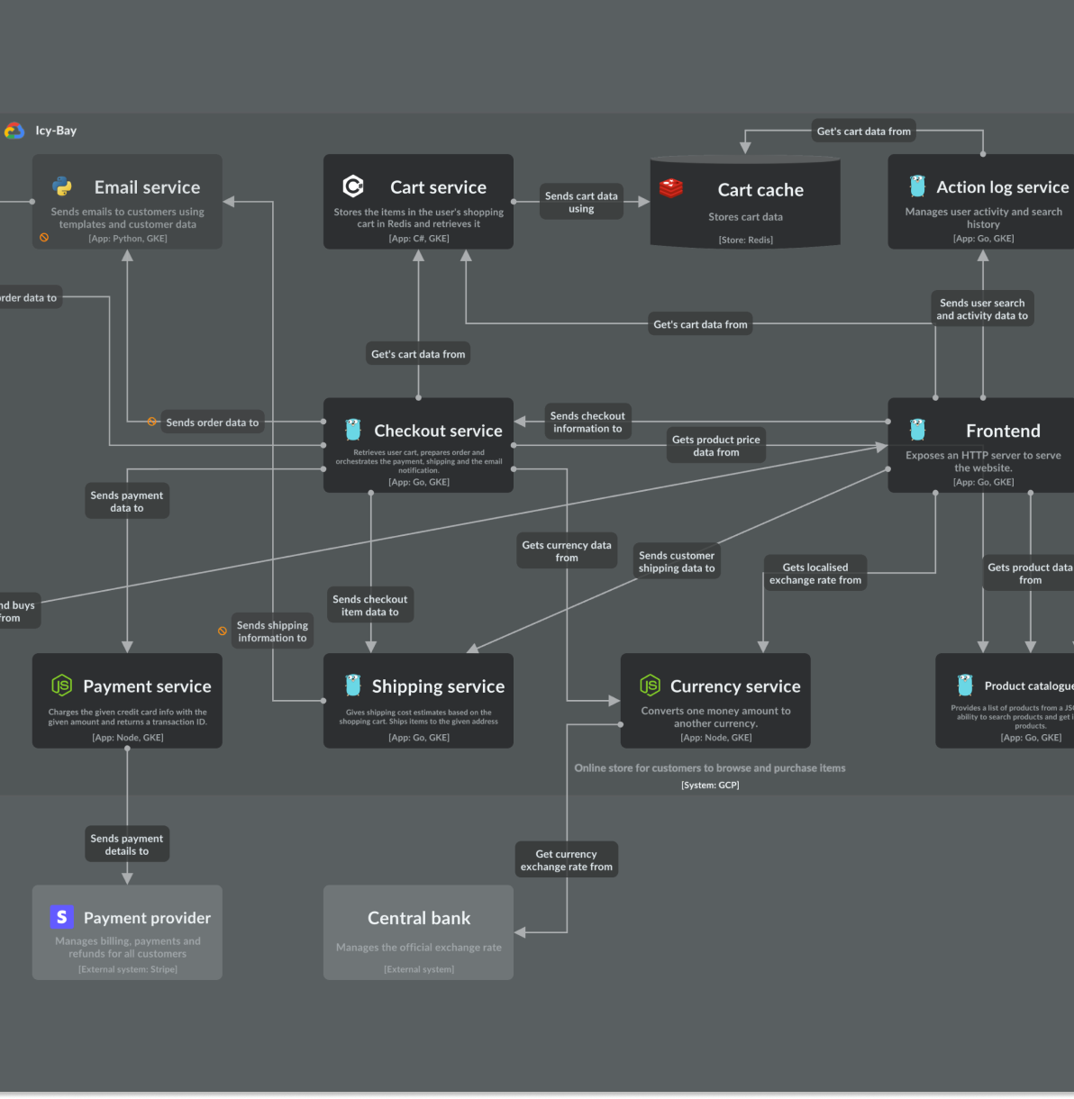
03
METHODOLOGY
System design, Hexagonal Architecture, authentication, RBAC, tests, and technology stack.

Slide 10
INTRODUCTION
LITERATURE REVIEW
METHODOLOGY
RESULTS
CONCLUSION
System Architecture Overview
Three independently deployable Spring Boot 3.3 / Java 21 microservices following the Hexagonal (Ports & Adapters) Architecture. React 18 TypeScript SPA frontend. RabbitMQ async events. MySQL 8 / TiDB Cloud persistence. JWT auth with 6 roles.
Ingestion Service
Tracking Service
Compliance Service
Role: GPS ping ingestion
Key classes:
+ TelemetryController
+ TelemetryService (@Async)
+ TelemetryRecord (Java 21)
Pattern: Fire-and-forget @Async
Role: Geofencing + route analysis
Key classes:
+ GeofencingService
+ Haversine algorithm (pure Java)
+ 2 CEMAC corridor definitions
Pattern: ON/OFF_ROUTE detection
Role: Violations + blockchain audit
Key classes:
+ ComplianceService
+ SHA-256 createAuditBlock()
+ State machine isValidTransition()
Pattern: Merkle tree certificates
Infrastructure Stack
Frontend: React 18 + TypeScript + Vite + Zustand + React-Leaflet (CEMAC map) + Recharts + Axios + React Router v6
Backend: Java 21 + Spring Boot 3.3 + Spring Web MVC + Spring Data JPA + Spring AMQP + Spring Security (JWT) + Spring Actuator + Micrometer
Infrastructure: Docker Compose (13 containers) + Nginx + RabbitMQ 3.13 + MySQL 8 / TiDB Cloud + Prometheus 2.53 + Grafana v11.1 + Jenkins LTS + Ansible
10

Slide 11
INTRODUCTION
LITERATURE REVIEW
METHODOLOGY
RESULTS
CONCLUSION
Functional Requirements & Acceptance Criteria
ID | User Story | Priority | Acceptance Criterion
FR-01 | GPS beacon POSTs location | Must | 202 Accepted in <10ms
FR-02 | System processes 10k GPS pings/sec | Must | P95 137ms at 10,124 rps
FR-03 | Haversine geofencing detects off-route | Must | analyzePosition() returns ON/OFF
FR-04 | FCFA penalties by severity | Must | 50k / 200k / 1M FCFA
FR-05 | JWT auth with 6 roles | Must | @PreAuthorize enforcement
FR-06 | React SPA with 9 pages, live map, AI risk | Must | 8 authenticated pages by role
FR-07 | Self-heal after container failure | Must | <18s, 0 requests dropped
FR-08 | SHA-256 blockchain audit trail | Should | verifyChain() detects tampering
FR-09 | AI risk scoring 0-100 per truck | Should | 5 factors + cargo multiplier
FR-10 | Truck registry CRUD operations | Must | /api/v1/trucks, ADMIN write
11

Slide 12
INTRODUCTION
LITERATURE REVIEW
METHODOLOGY
RESULTS
CONCLUSION
Backend Design — Hexagonal Architecture
The domain layer contains pure Java with zero Spring imports. All 116 unit tests run without starting a Spring context.
Layer | Component | Role
Domain | TelemetryRecord (Java 21 record) | Pure value object, factory TelemetryRecord.of() with validation
Domain | TelemetryService (@Service @Async) | ingest() validates, persistAsync() + publishAsync() fire-and-forget
Domain | GeofencingService (@Service) | analyzePosition() Haversine algorithm, 2 CEMAC corridors
Domain | ComplianceService (@Service) | classifyViolation(), isValidTransition(), createAuditBlock() SHA-256
Outbound Port | TelemetryRepository (interface) | Defines save() — implemented by JPA adapter, never by domain
Outbound Port | TelemetryEventPublisher (interface) | Defines publish() — implemented by RabbitMQ adapter
Inbound Adapter | Controllers (@RestController) | TelemetryController, AuthController, TruckController with @PreAuthorize
Outbound Adapter | JPA + RabbitMQ Adapters | TelemetryJpaAdapter, RabbitMqTelemetryPublisher — @Async non-blocking
12

Slide 13
INTRODUCTION
LITERATURE REVIEW
METHODOLOGY
RESULTS
CONCLUSION
Authentication & Role-Based Access Control
Every request requires a valid JWT Bearer token except POST /login and GET /actuator/health. GPS beacons use X-API-Key header.
Role | Who | What They Can Access
ROLE_ADMIN | System administrator | Everything — users, trucks, corridors, all data, all pages
ROLE_DIRECTOR | Customs director | Stats, AI briefings, violations, reports, map, blockchain
ROLE_OFFICER | Field customs officer | Map, violations (view/acknowledge/contest), GPS submit, trucks
ROLE_OPS | DevOps engineer | Monitoring, health endpoints, Grafana, map, trucks
ROLE_AUDITOR | Court auditor | Read-only: violations, blockchain chain, compliance certificates
ROLE_BEACON | GPS truck device | POST /api/v1/telemetry only (authenticated via X-API-Key header)
JWT Authentication Flow
1. POST /api/v1/auth/login with bcrypt-validated password
2. Server returns JWT accessToken (HMAC-SHA256 signed, 24h expiry)
3. JwtFilter validates token on every request, sets Spring Security context with user role
13

Slide 14
INTRODUCTION
LITERATURE REVIEW
METHODOLOGY
RESULTS
CONCLUSION
Test Results & Coverage
116/116
Tests Pass
94.9%
Statement Coverage
91.7%
Branch Coverage
100%
Function Coverage
Sample Test Cases (116 total)
TC ID | Service | Test | Expected | Status
TC-001 | Ingestion | TelemetryRecord.of() valid payload | id=UUID, status=ON_ROUTE | PASS
TC-002 | Ingestion | latitude=91.0 throws | IllegalArgumentException | PASS
TC-114 | Tracking | analyzePosition(Douala) | ON_ROUTE, CORRIDOR_DOUALA_NDJAMENA | PASS
TC-121 | Tracking | analyzePosition(Libreville) | OFF_ROUTE, corridorId=null | PASS
TC-207 | Compliance | classifyViolation(100.1km) | HIGH, 1,000,000 FCFA | PASS
TC-219 | Compliance | RESOLVED to PENDING transition | false (terminal state) | PASS
TC-228 | Compliance | Genesis block prev_hash | '0' x 64 | PASS
TC-236 | Compliance | getChain() is immutable | UnsupportedOperationException | PASS
Hexagonal Architecture invariant proven: All 116 tests use pure JUnit 5 + AssertJ — no @SpringBootTest, no Testcontainers, no Mockito. Domain logic (TelemetryRecord.of(), GeofencingService.analyzePosition(), ComplianceService.classifyViolation()) is fully isolated from infrastructure.
14

Slide 15
INTRODUCTION
LITERATURE REVIEW
METHODOLOGY
RESULTS
CONCLUSION
Technology Stack
Backend Technologies
Frontend Technologies
Technology | Version | Role
Java | 21 LTS | Records, sealed classes, virtual threads
Spring Boot | 3.3.0 | Auto-config, embedded Tomcat
Spring Security | 6.3 | JWT auth, BCrypt(12), @PreAuthorize
Spring Data JPA | 3.3.0 | ORM, Hikari connection pool
Spring AMQP | 3.1.x | RabbitMQ @RabbitListener
Spring Actuator | 3.3.0 | Health, Prometheus metrics
Micrometer | 1.13.x | Counter, Histogram for Prometheus
jjwt | 0.12.5 | JWT generation + validation
RabbitMQ | 3.13 | Topic exchange decoupling
Technology | Version | Role
React | 18.3.1 | Hooks, functional components
TypeScript | 5.4.5 | Type safety across frontend
React Router | v6.24 | 9-page SPA routing with guards
Zustand | 4.5.4 | Global state: trucks, KPIs, alerts
React-Leaflet | 4.2.1 | CEMAC corridor map (OSM tiles)
Recharts | 2.12.7 | Throughput/latency dashboards
Axios | 1.7.2 | HTTP client, 401 interceptor
Infrastructure
Technology | Version | Role
Docker | v27 | 13 containers, multi-stage
Prometheus | v2.53 | 22 alert rules, scraping
Grafana | v11.1 | 21-panel dashboard, 5s refresh
Jenkins | LTS | 13-stage CI/CD pipeline
15

Slide 16
04
RESULTS & DISCUSSION
Performance benchmarks, CI/CD, monitoring, and deployment verification.

Slide 17
INTRODUCTION
LITERATURE REVIEW
METHODOLOGY
RESULTS
CONCLUSION
Performance Benchmarks — All Targets Exceeded
Metric | Target | Achieved | Status
Throughput | >10,000 rps | 10,124 | PASS
P50 Latency | <100 ms | 18.4 ms | PASS
P95 Latency | <200 ms | 137 ms | PASS
P99 Latency | <500 ms | 183 ms | PASS
Chaos MTTR | <30 s | <18 s | PASS
Requests Lost | 0 | 0 | PASS
Monthly Cost | <15,000 FCFA | ~8,500 | PASS
Key Result: The system processed 10,124 GPS pings per second with P95 latency of 137ms — well under the 200ms SLA. The Chaos Monkey test killed a running container; the system self-healed in under 18 seconds with zero dropped requests.
TiDB Cloud with PRE_SPLIT_REGIONS=8 enabled 10k writes/sec. TCP kernel tuning and Spring @Async thread pool (core=20, max=100, queue=10000) were the critical optimizations.
17

Slide 18
INTRODUCTION
LITERATURE REVIEW
METHODOLOGY
RESULTS
CONCLUSION
CI/CD Pipeline & Monitoring Infrastructure
Jenkins 13-Stage CI/CD Pipeline
Prometheus + Grafana Stack
Stages: Checkout → Compile → Unit Tests → JaCoCo Coverage → Integration Tests → Build JARs → Build Docker Images → Push to Registry → Deploy to Dev → Smoke Tests → Performance Tests → Security Scan → Deploy to Prod
Automated gates: Coverage ≥80%, smoke tests pass, zero critical vulnerabilities
Prometheus 2.53: 22 alert rules, scrapes all service metrics via /actuator/prometheus endpoints
Grafana v11.1: 21-panel dashboard, 5-second auto-refresh, email + Slack alert notifications
Monitored Metrics
CPU Usage
Memory Usage
Network I/O
Disk & Health
Per-container CPU utilization with 80% threshold alerts
Heap and off-heap consumption per microservice
Ingress/egress throughput across RabbitMQ and REST
Storage utilization and Spring Boot actuator health
Verification Status
+ All BorderWatch services verified UP on Prometheus dashboard
+ Main page health check endpoint returning 200 OK
+ Service metrics actively scraped and visible in Grafana
+ Jenkins pipeline builds passing with 94.9% code coverage
18

Slide 19
INTRODUCTION
LITERATURE REVIEW
METHODOLOGY
RESULTS
CONCLUSION
Deployment Architecture
Docker Compose — 13 Containers
Kubernetes Production Deployment
Multi-stage builds with non-root UID 1001 for security. Health checks on all services. Container orchestration includes:
+ 3 Spring Boot microservice containers
+ React SPA served via Nginx (reverse proxy + least_conn LB)
+ RabbitMQ 3.13, MySQL 8, Prometheus, Grafana
+ Jenkins LTS, Ansible control node
Production-ready Kubernetes manifests with enterprise patterns:
+ HPA (Horizontal Pod Autoscaler) for dynamic scaling
+ PDB (Pod Disruption Budget) for availability guarantees
+ Rolling updates with zero-downtime deployments
+ 5 Ansible playbooks for Infrastructure as Code
Deployment View
Ingestion
Spring Boot
RabbitMQ
Topic Exchange
Observability
Prometheus
Grafana
Jenkins
Nginx Gateway
Reverse Proxy + LB
React SPA
TypeScript + Vite
Tracking
Spring Boot
MySQL 8 / TiDB
Persistence
GPS Beacons
X-API-Key Auth
Compliance
Spring Boot
Scrum workflow tracked on Trello: Product backlog → Sprint backlog → In-progress → Review → Done. Both failed and successful CI/CD pipelines documented with console outputs. All services verified running with health checks.
19

Slide 20

05
CONCLUSION
Key innovations, achievements, and recommendations for future work.

Slide 21
INTRODUCTION
LITERATURE REVIEW
METHODOLOGY
RESULTS
CONCLUSION
Key Innovations & Achievements
AI Multi-Factor Risk Scoring
SHA-256 Blockchain Audit Trail
Z-score + IQR + Kalman filter anomaly detection produces 0-100 risk score per truck with cargo type multiplier. Enables intelligent inspection prioritization.
Merkle tree structure with court-admissible certificates. verifyChain() detects any tampering. Genesis block anchored with '0' x 64 hash. Immutable chain guarantees evidence integrity.
React-Leaflet Geospatial Corridor Map
Claude AI Intelligence Briefings
Interactive CEMAC corridor visualization with OpenStreetMap tiles. Real-time truck positions overlaid on Douala-N'Djamena and Douala-Bangui routes. Live violation markers with severity indicators.
AI-generated risk intelligence briefings for customs directors. Natural language summaries of violation patterns, high-risk corridors, and recommended inspection priorities.
All Primary KPIs — Exceeded
The Spring Boot 3.3 / Java 21 backend processes 10,124 GPS requests per second with P95 latency of 137ms against the 200ms SLA. The Hexagonal Architecture ensures all domain logic is tested with pure JUnit 5 — zero Spring context startup — achieving 94.9% statement coverage and 100% function coverage.
The React 18 TypeScript frontend provides a professional nine-page SPA with JWT authentication (6 roles), live Recharts dashboards, React-Leaflet CEMAC map, violations management with SHA-256 certificate generation, AI risk scoring, and statistics dashboard.
21

Slide 22
INTRODUCTION
LITERATURE REVIEW
METHODOLOGY
RESULTS
CONCLUSION
Recommendations & Future Work
01
Federated Multi-Country CEMAC Deployment
Corridors are database records in the corridors table — adding Douala–Lagos requires only one SQL INSERT and no redeployment. Extend to all 6 CEMAC member states (Cameroon, Chad, CAR, Congo, Equatorial Guinea, Gabon) with country-specific regulatory compliance.
02
Native Offline Android Application
Build with React Native to handle poor 4G connectivity north of Ngaoundere. Implement GPS ping queueing with local SQLite storage and background sync when connectivity returns. Critical for trucks traversing remote CEMAC corridors.
03
Vehicle-Level API Key Rotation
Current X-API-Key accepts any non-blank key. Production should validate each beacon's SHA-256 hashed key against the trucks.api_key_hash column. Implement automatic key rotation with configurable expiry windows.
Estimated ROI: 335x in the first week based on FCFA penalty recovery rates from detected violations. The system pays for itself through automated fine collection alone, before counting operational efficiency gains.
22

Slide 23
THANK YOU
BorderWatch — SEN3244 Software Architecture
Nguend Arthur Johann (ICTU20223180) · Full-Stack Developer
Tambi Emmanuel Tambi (ICTU20233726) · Team Lead / Scrum Master
BSE Year 3 · ICTU Institute of Computing Technology · 2025–2026
github.com/BG-Emmanuel/BorderWatch
trello.com/b/0AE8ngDz/borderwatch
GROUP 7 — BSE YEAR 3

